Slide 1
Plasma Etch for IC Fabrication

Slide 2
Etching Processes
Wet Etch
Dry Etch
  Plasma Etch
  RIE
  High Density Plasmas
Etch Model
Etch Issues
  Polymer formation
  Selectivity
  Uniformity
Applications

Slide 3
Photolithography
Develop resist and hardbake
Oxide
Etch oxide
Strip resist

Slide 4
WET ETCHING
DISADVANTAGES
1 um
3 um
Resist
1 um
5 um
3 um
3 um
Because the etch is purely chemical wet etches are isotropic i.e. vertical and lateral etch rates equal
The main limitation is size of detail which can be etched consistently
In some cases it is difficult for etchant to reach bottom of detail and for by-products to be removed
Can be difficult to control temp,pH etc.

Slide 5
Dry Etch Processes
Introduction
Plasma/RIE (Dry) Etching
Polymer Formation
Applications
  Nitride Etch
  Polysilicon Etch
  Contact Etch
  Aluminium Etch

Slide 6
DRY ETCHING
Resist
Dry etching has become widely used for process geometrys below ~ 3μm
Dry etching combines physical and chemical removal of material
Controlling the etch process conditions allows the isotropy of the etch to be controlled

Slide 7
DRY ETCHING
Electrode
Plasma
RF
Wafer
Electrode
Dry etching is performed by exposing the wafer to a plasma or glow discharge
Plasmas are usually created by applying an R.F. bias between two electrodes.

Slide 8
R.F. electrical supply
Current
Time
One Cycle
R.F. is short for radio frequency
R.F. is a form of alternating current i.e. current follows a sinusoidal waveform with respect to time
This is similar to mains electricity but the time for one cycle is much shorter
  A.C. mains supply 2 x 10 ⁻² sec (50 Hz)
  R.F. supply 7 x 10 ⁻⁸ sec (13.5 MHz)

Slide 9
Plasma Potential
Powered
Electrode Vt
Plasma Vp
Floating
Surface, Vf
RF
Ion
Sheaths

Slide 10
Plasma Potential Plot
V+
Vp
0
Vf
V-
Vt
Smaller Electrode

Slide 11
Configuration of Plasma Etching Systems
Wafer is placed on grounded electrode
This results in a relatively low bias at wafer
Plasma etching uses chemically reactive gases
Typical Values
DC Voltage drops 10-100V
Pressure 100mT -1Torr
Electrode
Plasma
RF
Wafer
Electrode

Slide 12
Configuration of Reactive Ion Etching (RIE) Systems
Typical Values
DC Voltage drops 100-700V
Pressure 10 - 100mT
Electrode
Plasma
RF
Wafer
Electrode
Wafer is placed on powered electrode
This results in higher biases at the wafer surface
RIE etching uses chemically reactive gases
Ion milling uses the same configuration as RIE etching but uses inert gases

Slide 13
Dry Etch Chemistry
Plasma etching and RIE etching use the same chemistries
  Fluorine containing gases are commonly used for etching silicon oxide and silicon nitride e.g. silicon tetrafluoride(SiCl₄), sulphur hexafluoride(SF₆)
  Chlorine containing gases are commonly used for etching metal and polysilicon e.g. chlorine, boron trichloride

Slide 14
Dry Etch Chemistry
+
RF
fragments+ e⁻
+
Trifluoromethane (CHF₃) is commonly used for the etching of silicon dioxide based materials
Radicals: CHF₃ ---> e.g. CF₃ , CF₂ , CF, F, H
Ions: CHF₃ ---> e.g. CF₃+ , CF₂ +, CF+, F+, H+

Slide 15
Dry Etch Chemistry
Ion Radical
+
*
As stated previously dry etching achieves anisotropy by introducing physical component
Physical component of etch is supplied by attraction of positive ions to the negatively biased substrate
Chemical component from both ion and radical interaction

Slide 16
Ion induced reactions
Cl Only
Ar plus Cl
Etch Rate
0
Time
Under certain etch conditions etch rate of silicon is negligible
Adding Ar to gas flow increases etch rate
Ar ion bombardment of surface damages it making chemical reaction with Cl easier

Slide 17
Ion enhanced reactions
XeF₂ Only
Ar plus XeF₂
Ar Only
Etch Rate
0
Time
Some etching without inert gas
Etch rate increases with inert gas
No etching without reactive gas

Slide 18
High Density Plasmas (HDP)
Relatively new systems generating higher density plasmas
  ICP (Inductively Coupled Plasmas)
  ECR (Electron Cyclotron Resonance)
  M0RI (Magnetic Zero Resonant Induction)
Plasma density {10¹¹ - 10¹² (10¹⁸?) ions/cm³}
Allow higher etch rates at lower pressures without plasma damage
Pressure range 1 - 10mT range

Slide 19
Inductively Coupled Plasma (ICP)
Induction Coil 13.56MHz
Plasma is generated in the induction coil
The wafer is held on the chuck electrostatically
ElectroStatic Chuck
13.56 MHZ

Slide 20
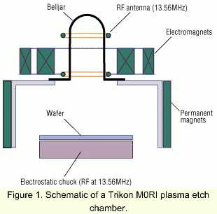
Magnetic Zero Resonant Induction M0RI
The plasma in generated by the RF antenna
A helicon wave is propagated by the Electromagnets
The wafer is held on an electrostatic chuck
  Helicon wave - whistler wave!

Slide 21
Etch System Summary Trends
Sputter Etch &
Ion Beam Milling
Physical
Processes
High Density Plasma Etch
Pressure
Energy
Reactive ion Etch
Selectivity
Anisotropy
Plasma Etch
Chemical
Processes
Chemical Etch

Slide 22
Process Summary
+
Resist Erosion
Masking
Material
Undercutting
Sidewall polymer
deposition
Chemical Etching
Trenching
Physical Etching

Slide 23
Linear Etch Model
Simplest model assumes that the Chemical and Ionic etch rates are linear and independent
The net etch rate at any point is a combination of the purely chemical and ion-driven etching with each term linearly dependant on the appropriate flux

Slide 24
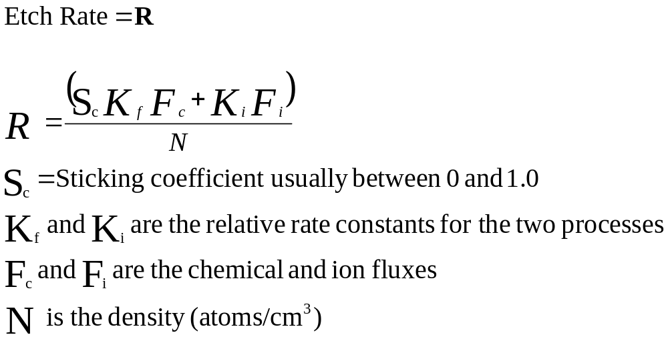
Linear Etch Model Equation

Slide 25
Etch Model Example
Chemical and Physical / Ionic etching
Chemical only
Chemical only

Slide 26
Polymerisation
Teflon
F
F
F
F
F
F
F
F
F
n
C
C
C
C
C
C
C
C
C
F
F
F
F
F
F
F
F
F
Monomer Polymer
Polymers are formed by chain linking monomers
Above reaction is typical of a polymerisation process
The number of monomer units in the polymer can be 10,000s

Slide 27
Polymer formation in a plasma
Example:
CHF₃ is commonly used for oxide etching
CF₂ is produced by the reaction CHF₃ ---> CF₂ + H + F
CF₂ can then polymerise to form a teflon like polymer
F
F
F
F
F
F
F
F
n
C
+ e⁻
-------->
C
C
C
C
C
C
C
F
F
F
F
F
F
F
F

Slide 28
Polymer inhibiting reaction
Resist
Polymer
Oxide
Silicon
This reaction is used when etching oxides to improve selectivity to underlying material
The polymer deposits more quickly on silicon than on silicon dioxide thus slowing the etch when the oxide has been removed

Slide 29
Polymer enhancing anisotropy
Resist
Metal
Oxide
Metal anisotropy is maintained by the deposition of polymer on sidewall of metal
The polymer consists of etch by-products and resist erosion products
The polymer is also deposited on horizontal surfaces but ion bombardment causes desorption

Slide 30
Uniformity
  +
+ + +
  +
Unif = Max - Min x 100 %
  2 x Mean
Uniformity is a measure of the variation in etch rate across a wafer
For most etch processes should be < 5%

Slide 31
Selectivity
Resist
Thin gate oxide
Poly
Silicon

Slide 32
Selectivity
Selectivity is the ratio of etch rates
e.g. Poly-Oxide selectivity is:
Etch rate poly
Etch rate oxide
Selectivity is an important consideration when trying to predict the amount of material removed underneath the etched pattern
Example shown above where thin gate oxide under poly gate must be left intact

Slide 33
Contact etching
Anisotropic
Metal
Taper
Champagne

Slide 34
Contact Etching
For contacts 1.5μm and below metal step coverage can be a problem i.e. too thin in contact hole
This can be improved by taper or champagne etch
Alternatively selective tungsten plug metallisation is used which completely fills anisotropically etched contact

Slide 35
Contact etching
Oxide 1
Oxide 2
Source/ Drain
Due to uneven topography it is sometimes necessary to etch through different oxide thicknesses
Also different oxides can have different etch rates e.g. thermal/deposited, doped/undoped

Slide 36
NMRC Contact Etch Recipe
Step 1 C2F6 0 sccm Power 250 W
    CHF3 65 sccm Pressure 1000 mT
    O2 35 sccm Time 15 sec.
    The oxygen erodes the resist CHF3 etches oxide
Step 2 C2F6 23 sccm Power 275 W
    CHF3 143 sccm Pressure 155 mT
    O2 0 sccm Time Endpoint
    This is the bulk etch and etches most of the BPSG
    Endpoint is indicated by changes in plasma colour
    40% overetch to clear all contacts
Step 3 C2F6 120 sccm Power 70 W
    CHF3 0 sccm Pressure 180 mT
    O2 14 sccm Time 15 sec.
    Low power step to remove damaged silicon and polymer.

Slide 37
Poly etching
RESIST
Thin
Gate
Oxide
< 200Å
POLY
Silicon
As device dimensions shrink gate oxides become thinner
Acceptable gate oxide loss =/< 50Å
High selectivity between poly and gate oxide required

Slide 38
Double Poly Etch I
OXIDE
POLY
POLY 2
OXIDE
POLY
OXIDE

Slide 39
Double Poly Etch II
Double
Thickness
Here
Resist
POLY 2
POLY 1
Resist
Poly Stringers/Fillets
POLY 2
POLY 1
Because poly is thicker at step poly 2 needs to be overetched
Overetching can cause problems with polyoxide loss or undercut on poly 2

Slide 40
NITRIDE ETCHING
Out diffusion of boron
Process sequence
Nitride photo
Nitride etch
Resist strip
Field implant
Field oxide
Nitride
Pad Oxide
Boron implanted silicon
G
S
D
Field Oxide
N
N
Boron depleted silicon
If the pad ox is excessively thin, dopant implanted in field can be lost during field oxide growth
Therefore pad oxide loss should be kept to a minimum during nitride etch

Slide 41
Metal etching
Sidewall
Passivation
RESIST
METAL

Slide 42
Metal Etching
Atomic chlorine produced in plasma will readily etch aluminium
To prevent lateral etching of the metal the sidewalls of the metal are passivated by etch residues
A high resist erosion rate is required for this passivation
This passivation contains chlorine and can react with moisture when exposed to air causing corrosion problems
Therefore resist must be ashed soon after etch

